Slide 1
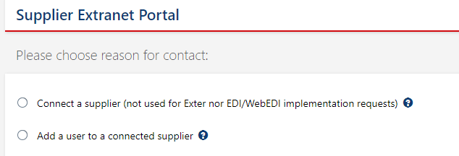
How to request access to UD VVI for a supplier
https://forms-ud.cloud.volvogroup.com/Mailforms4/MailformsWeb/Logon.aspx?class=APPS/BUILDER/UD_PORTAL/
Buyers should request to add new suppliers and to add new users for an existing supplier
  You must have the supplier Parma#
  The names of the users that want access
  The user’s email addresses
Users will receive their log on information by email
Set up can take up to 48 hours
Please click on the link above and fill out the required information

